Slide 1
IPC 2011
Überblick Themen

Slide 2
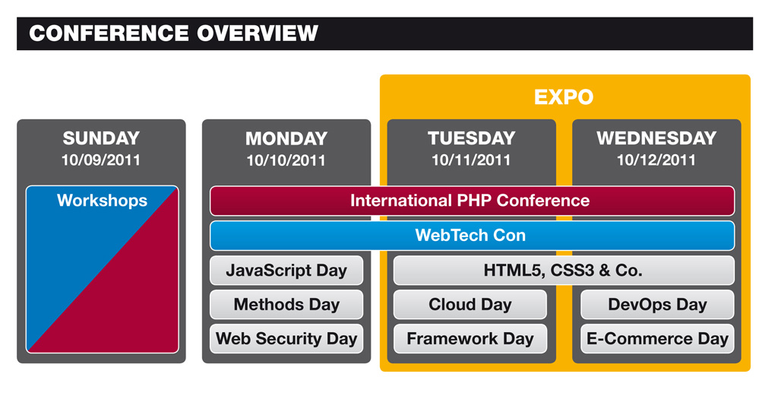

Slide 3
Verweise
http://joind.in/event/view/806
http://qafoo.com/presentations.html
http://sinonjs.org/qunit/
http://packages.zendframework.com/docs/latest/manual/en/index.html
http://butunclebob.com/ArticleS.UncleBob.PrinciplesOfOod

